Slide 1
The 9th Triennial International Aircraft Fire and Cabin Safety Research Conference
Crash Simulation of YS-11 Transport Fuselage Sections
October 31st ,2019 Atlantic City, NJ, USA
Hiromitsu Miyaki¹, Hiroyuki Akiyama², Takao Okada¹, and Hirokazu Shoji¹
1. Japan Aerospace Exploration Agency, 2. Ryoyu Systems

Slide 2
Motivation
Crash simulation model for the conventional fuselage structure validated by full-scale tests data is beneficial to:
Investigate the crashworthiness performance in variety of conditions in order to compare with the novel design/material fuselage.
- Size effect
- Subfloor structural configuration
- Loading condition (cargo/occupants)
- Impact velocity etc.
Obtain crashworthiness simulation methodology as a baseline for the simulation of novel design/material fuselage.

Slide 3
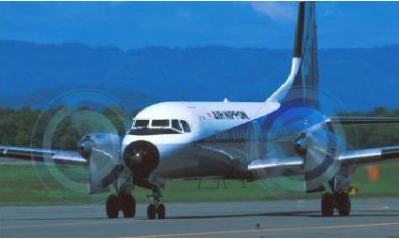
Aircraft used for drop test
YS-11A Commuter Crass Transport
Specifications
Fuselage Diameter : 2.88 m
Max.T/O Weight : 24.5 ton
Passengers : Max. 64
Wing Span : 32.0 m
Overall Length : 26.3 m
Tail Height : 9.0 m
Cruising Speed : 450 km/h
First Flight : Aug. 30th, 1962
TC Approved : Sep. 7th 1965
(before FAR25.561)
NAMC YS-11A

Slide 4
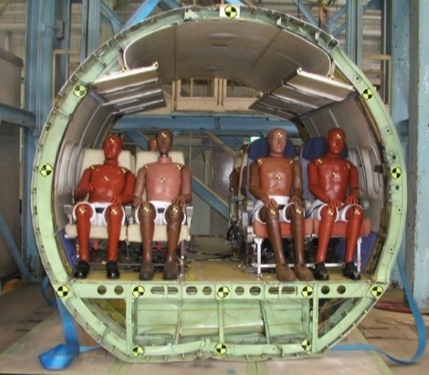
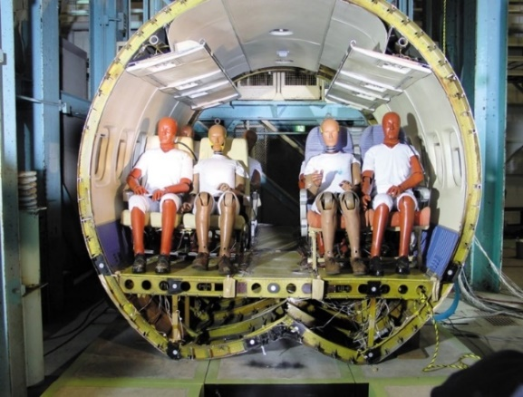
YS-11 Fuselage Sections
FSTA. 0
-8080
-4950
+1800
+5160
- Forward section
- Test date: 2nd drop test (Jul. 7th 2002)
- Occupants: 12 (12 ATDs)
- Gross weight: 1,600kg
- Impact velocity: 7.40m/s (approx. 25fps)
- Impact surface: concrete platform
- Cargo compartment(empty), cargo door
- Rear section
- Test date: 1st drop test (Dec. 20th 2001)
- Occupants: 12 (8ATDs, 4 dummy weights)
- Gross weight: 1,510kg
- Impact velocity: 6.08m/s (approx. 20fps)
- Impact surface: concrete platform
- Without cargo compartment, subfloor access door

Slide 5
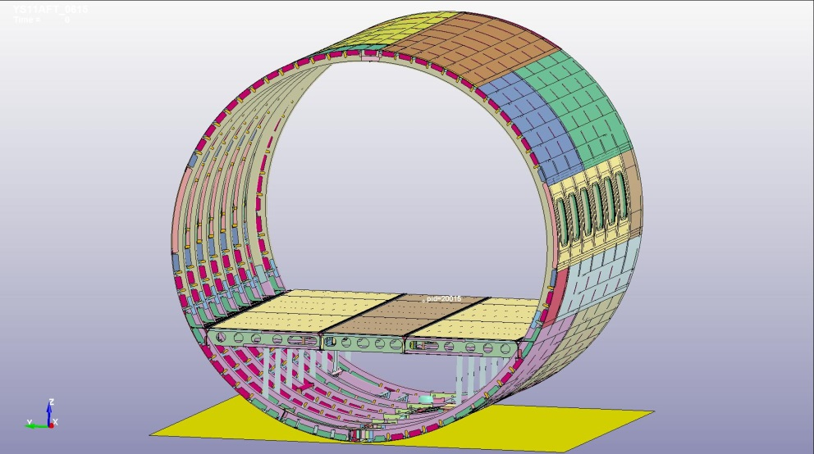
Analysis for the 1st drop test (YS-11_AFT model)
Model Summary
- Lamped masses to nodes on seat rails
instead of ATDs / seats
- 956169 elements
- 1089627 nodes
- Total mass : 1510 kg
- Impact velocity : 6.08 m/s (approx. 20 fps)
Mesh Quality Criteria
Jacobian | < 0.7
Aspect Ratio | < 5
Element size | 5 mm to 20 mm
Angle quad. | 45 deg to 135 deg
Angle tria. | 30 deg to 120 deg
Warpage | < 15 deg
“YS-11_AFT” analysis model

Slide 6
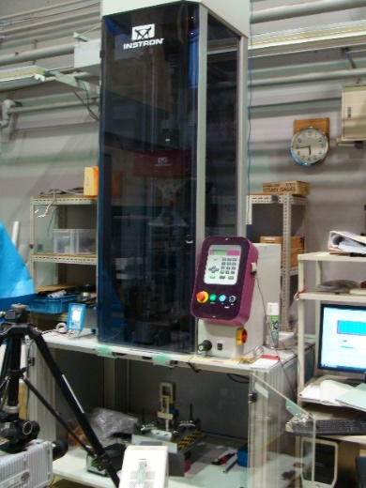
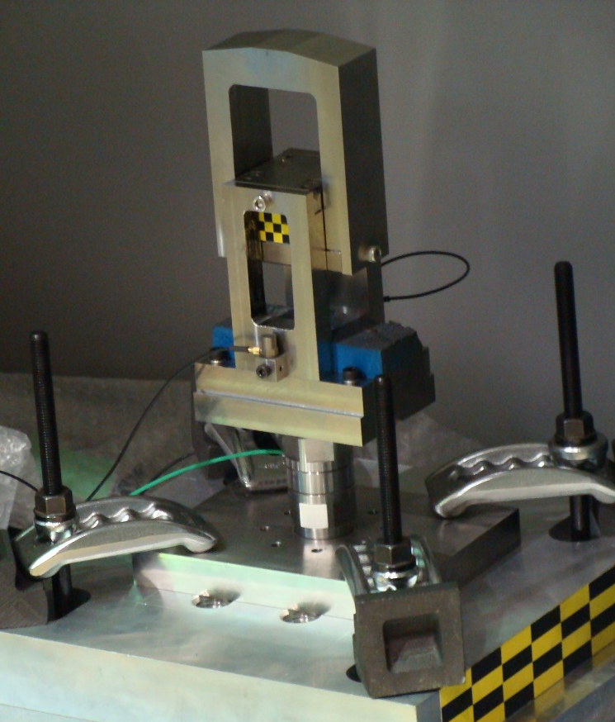
Single Fastener Dynamic Characteristics test
Impactor
Test Specimen: Rivet
Test Jig
Fixture
Moving fitting
Accelerometer :
Cancel the inertia force
of the test fixture
High speed video
Measure the
displacement
Load cell
冶具と駒の動き
Test setup

Slide 7
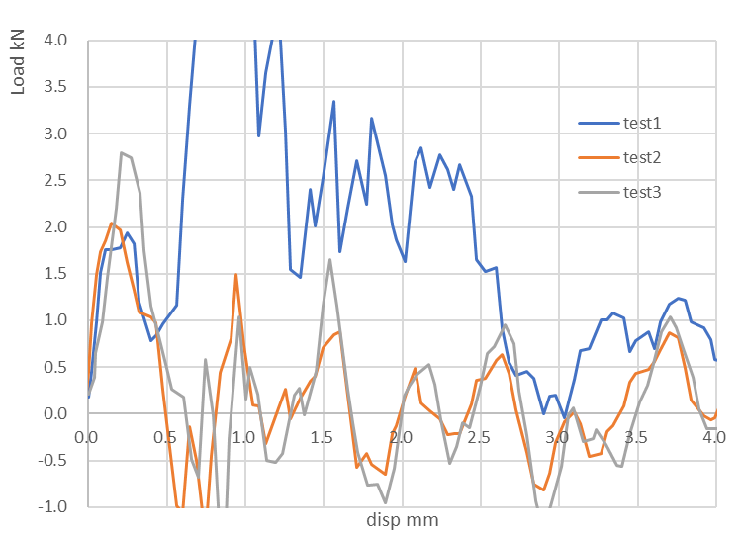
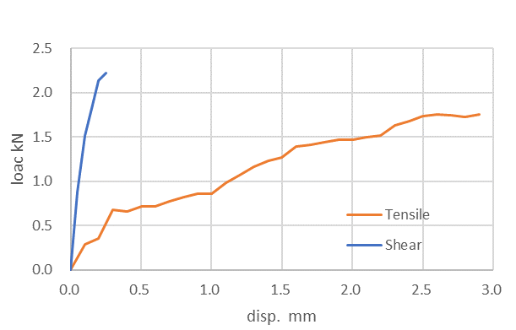
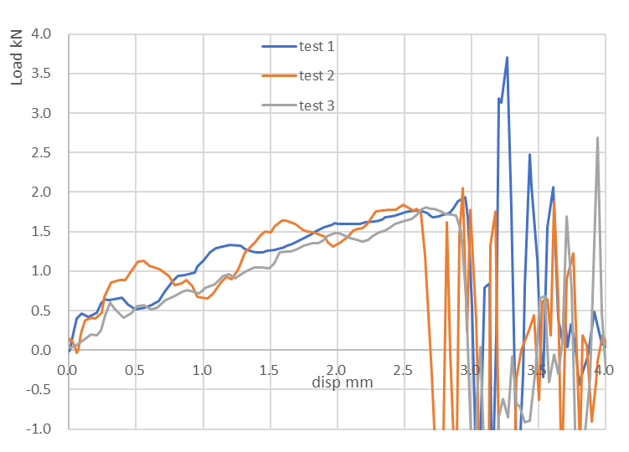
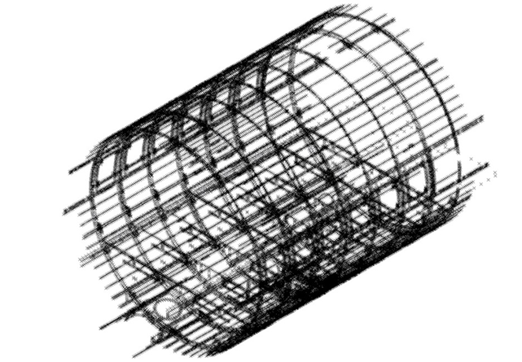
Fastener Model
Rivet failure
Fastener Model
- Mesh-Independent Spot-weld Beams
- Material : Nonlinear 3DOF springs
- Input load-displacement curve scaled by fastener dimensions
Single rivet share braking test data (2m/s)
Rivet failure
Analysis fastener material data
Single rivet tensile braking test data (2m/s)
Fastener points on the fuselage

Slide 8
Analysis for the 1st drop test (YS-11_AFT model)
Kinematic
“YS-11_AFT” analysis model

Slide 9
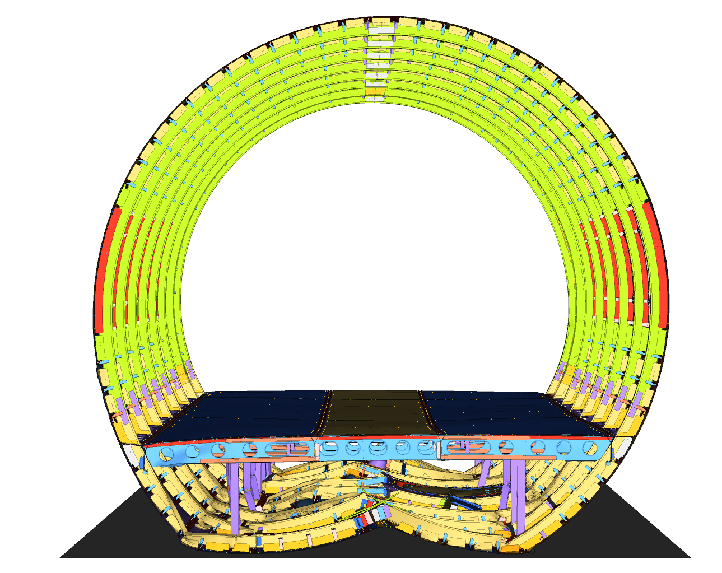
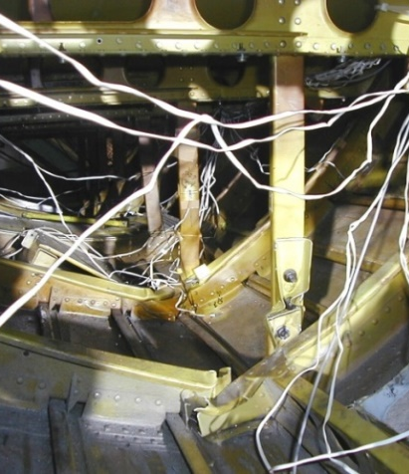
Analysis for the 1st drop test (YS-11_AFT model)
Deformation
Front view
Bottom of fuselage
Floor Strut

Slide 10
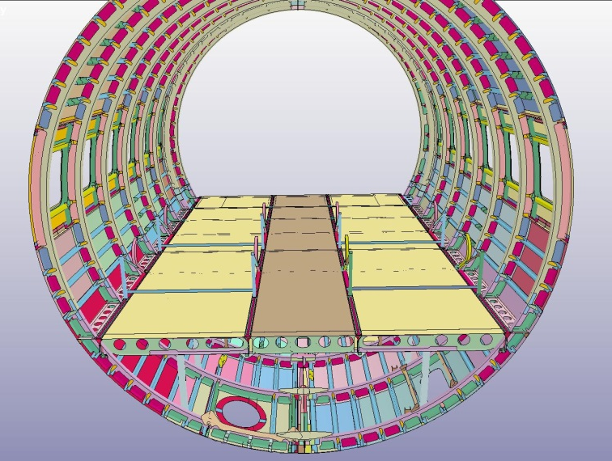
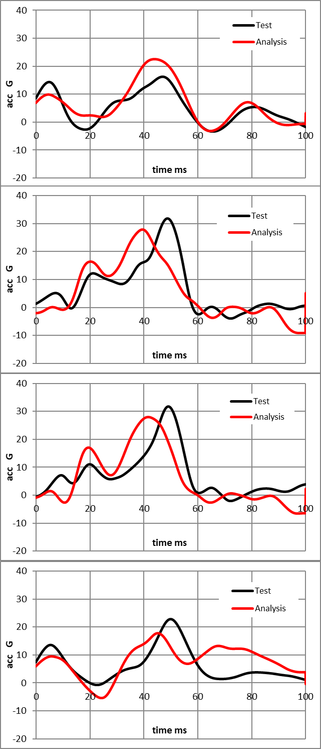
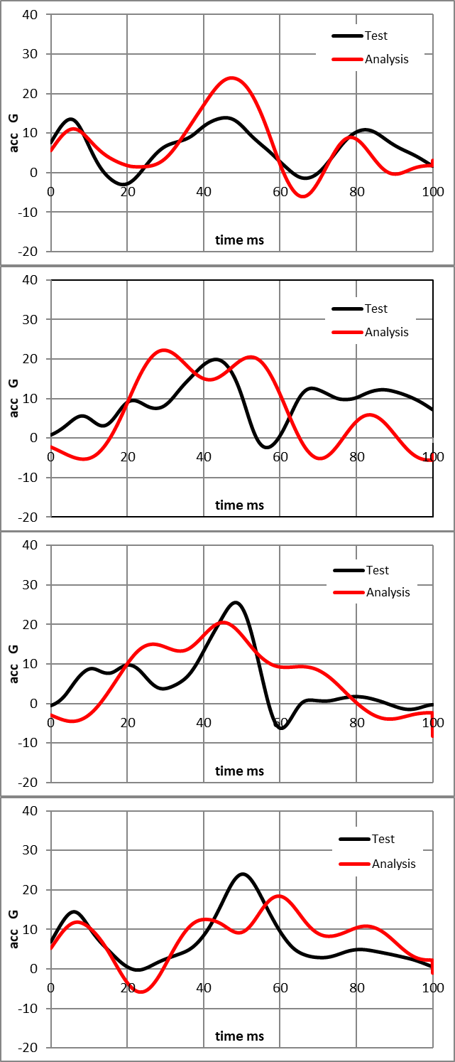
1. Analysis for the 1st drop test (YS-11_AFT model)
Test-Analysis correlation -acceleration time histories on cabin floor (CFC20)
STA +1800
STA +2280
01
05
08
07
06
05
04
03
02
01
02
06
03
07
04
08

Slide 11
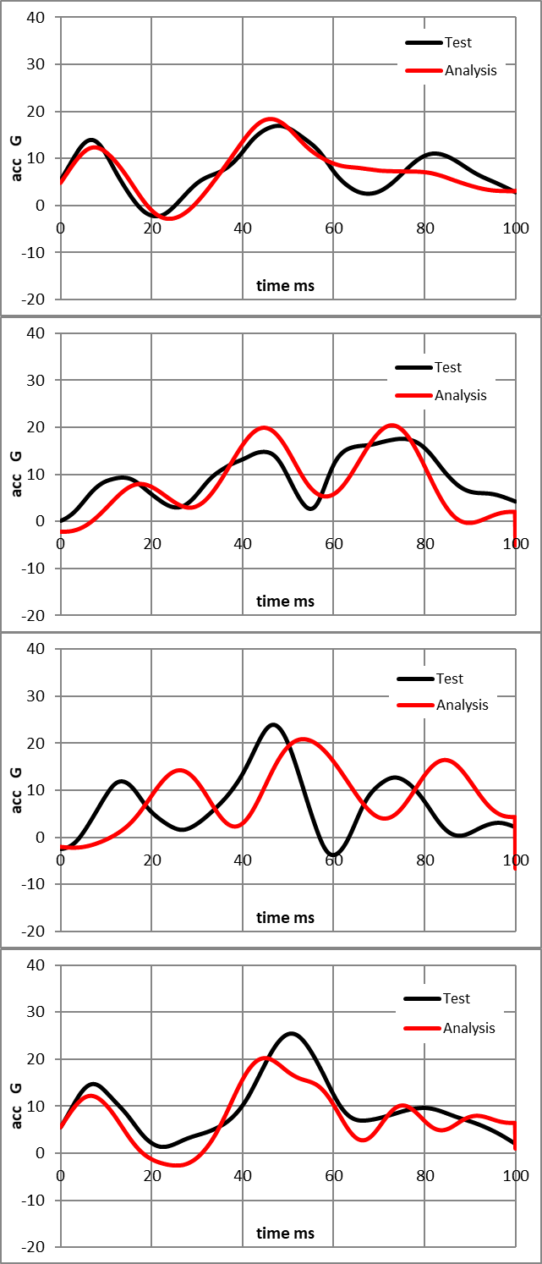
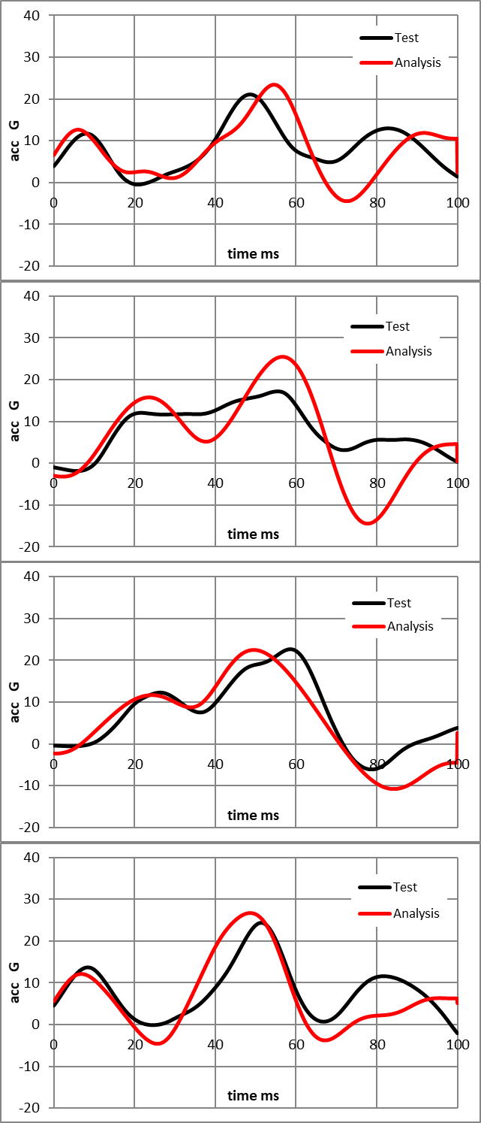
1. Analysis for the 1st drop test (YS-11_AFT model)
Test-Analysis correlation -acceleration time histories on cabin floor (CFC20)
STA +3240
STA +4680
16
15
14
13
09
13
12
11
10
09
10
14
11
15
12
16

Slide 12
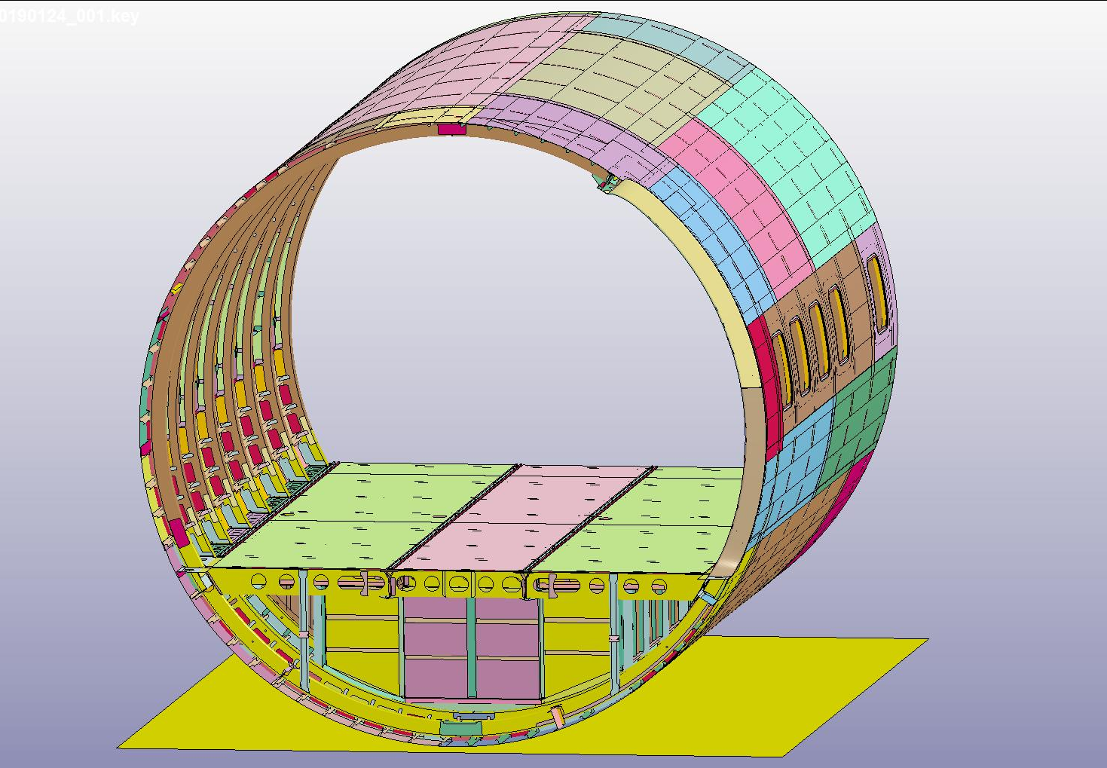
Analysis for the 2nd drop test (forward fuselage)
・ Model Summary
- Add under floor cargo compartment
- No seats model
- Lamped masses to nodes on seat rails
instead of ATDs / seats
- 1124103 elements
- 1272519 nodes
- Total mass : 1600 kg
- Impact velocity : 7.40 m/s (applox.25 fps)
Mesh Quality Criteria
Jacobian | < 0.7
Aspect Ratio | < 5
Element size | 5 mm to 20 mm
Angle quad. | 45 deg to 135 deg
Angle tria. | 30 deg to 120 deg
Warpage | < 15 deg
“YS-11_FRO” analysis model

Slide 13
Analysis for the 2nd drop test (YS-11_FRO model)
Kinematic
“YS-11_FRO” analysis model

Slide 14
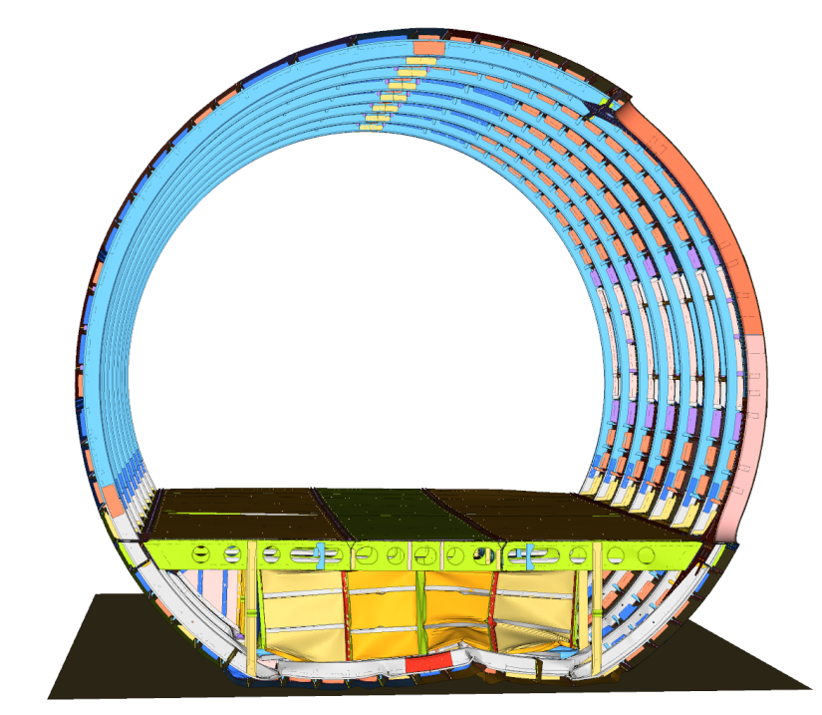
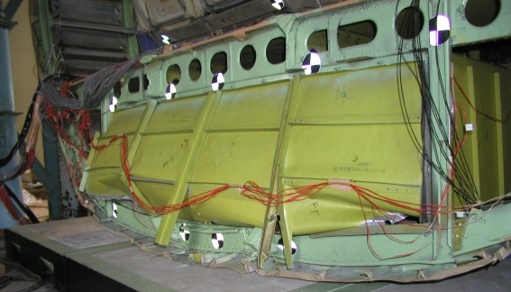
Analysis for the 2nd drop test (YS-11_FRO model)
Deformation
Front view
Rear view

Slide 15
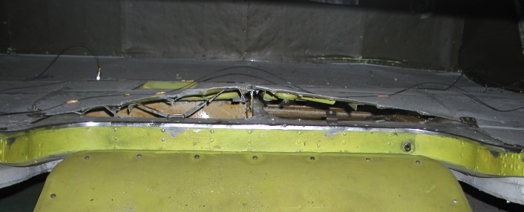
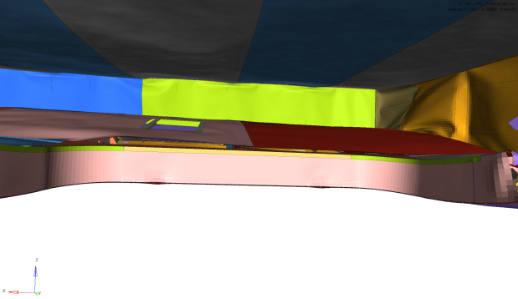
Analysis for the 2nd drop test (YS-11_FRO model)
Deformation
Bottom of fuselage
Inside of Cargo Compartment

Slide 16
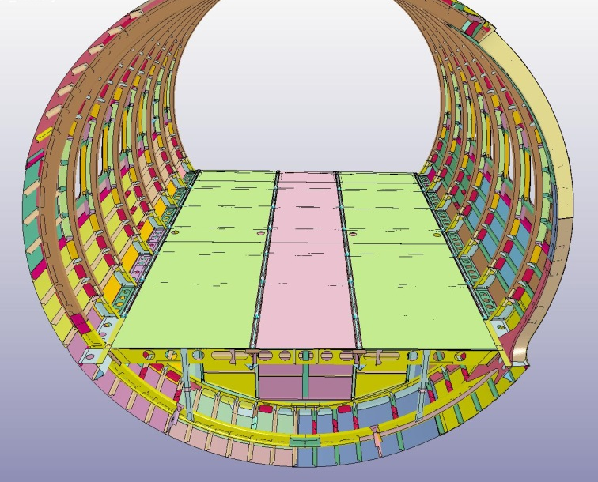
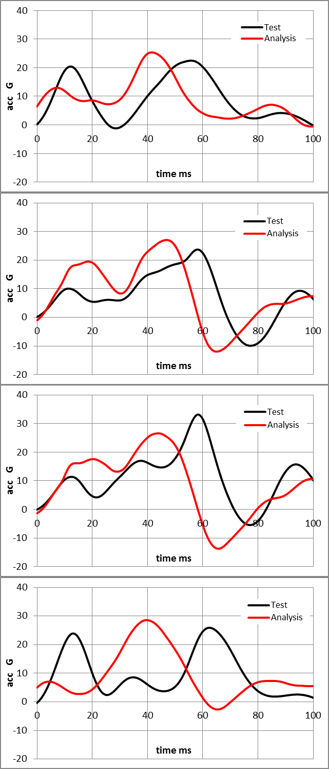
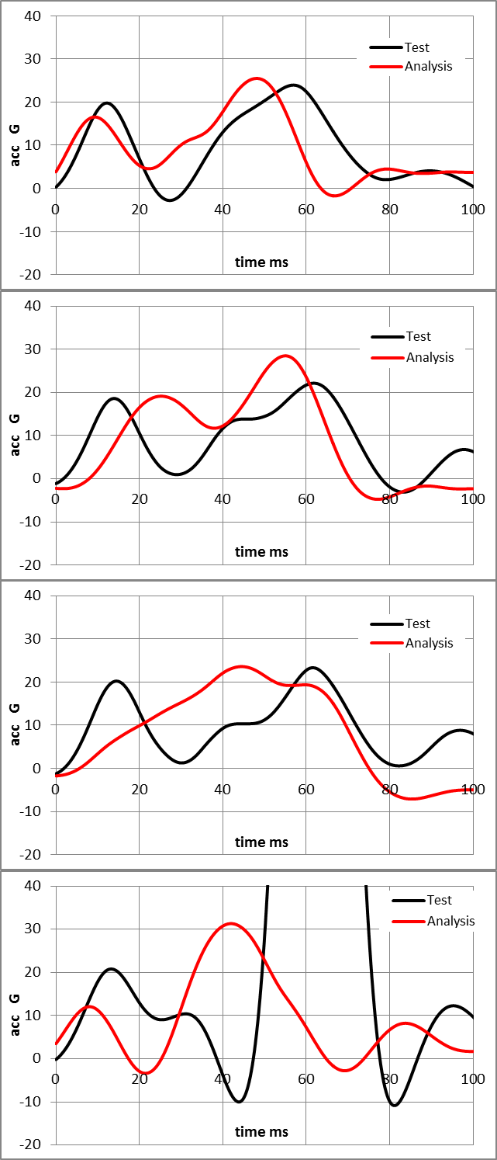
Analysis for the 2nd drop test (YS-11_FRO model)
Test-Analysis correlation -acceleration time histories on cabin floor
STA -8080
STA -7278
01
05
08
07
06
05
04
03
02
01
02
06
03
07
04
08

Slide 17
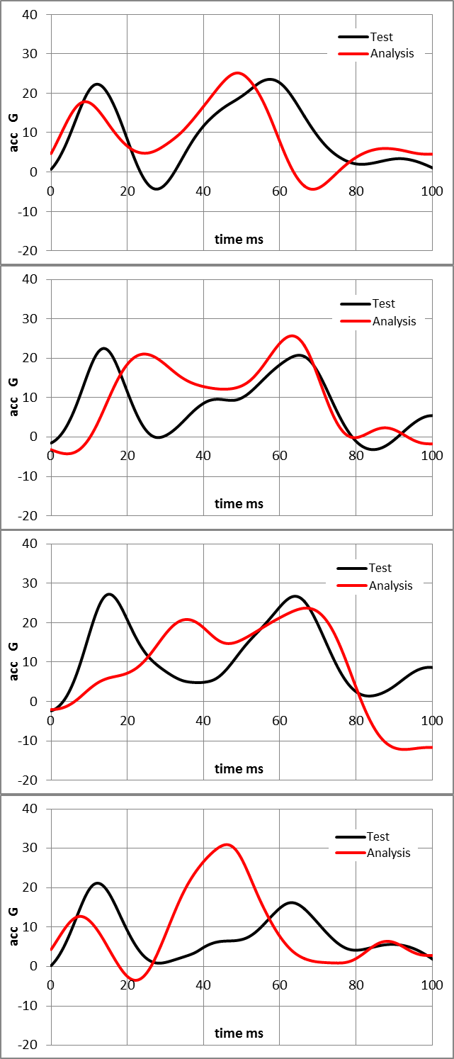
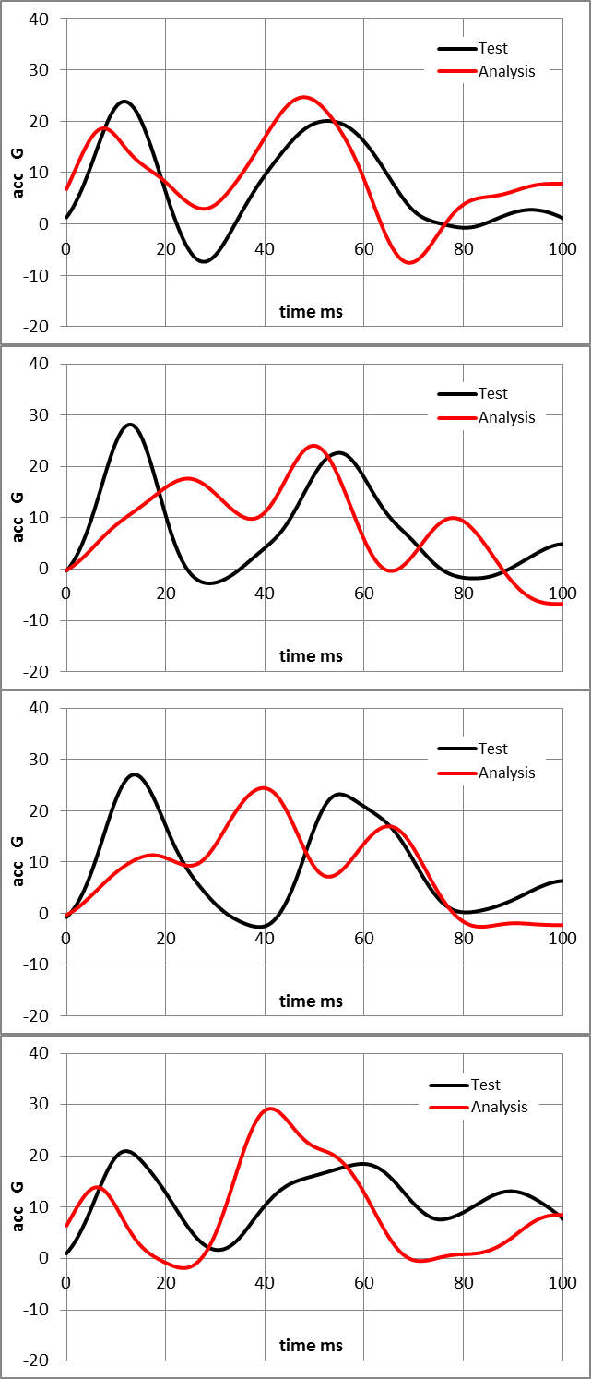
Analysis for the 2nd drop test (YS-11_FRO model)
Test-Analysis correlation -acceleration time histories on cabin floor
STA -6390
STA -5430
16
15
14
13
09
13
12
11
10
09
10
14
11
15
12
16

Slide 18
Comparison of two models at 30fps impact
1. Analysis model summary
Model Summary
- No seats model
- Lamped mass to nodes on seat rails
instead of ATDs & seats
- Common impact velocity : 9.14 m/s (about 30 fps)
Model type | YS-11_AFT | YS-11_FRO
Elements | 956169 | 1124103
Nodes | 1089628 | 1272519
Total mass | 1510 kg | 1600 kg
“YS-11_AFT_30fps” analysis model
“YS-11_FRO_30fps” analysis model

Slide 19
Comparison of two models at 30fps impact
Kinematics
YS-11_AFT_30fps
YS-11_FRO_30fps

Slide 20
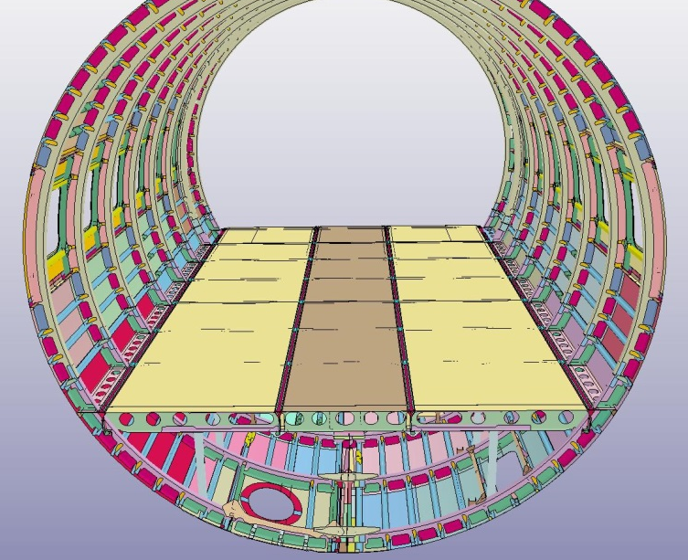
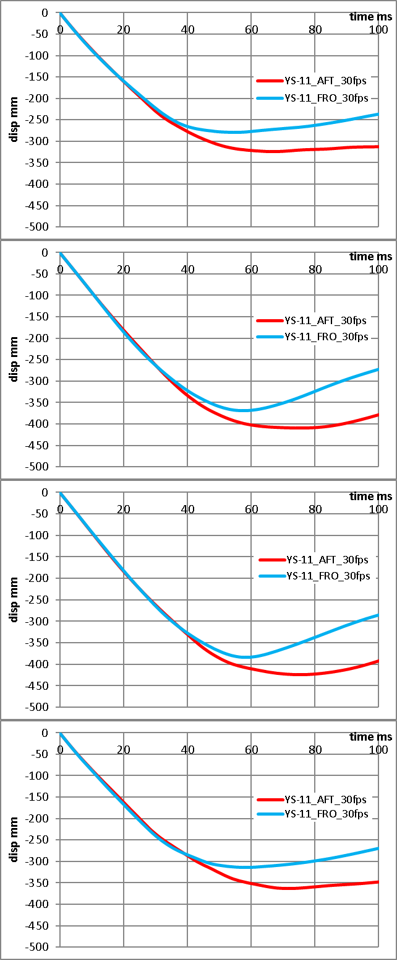
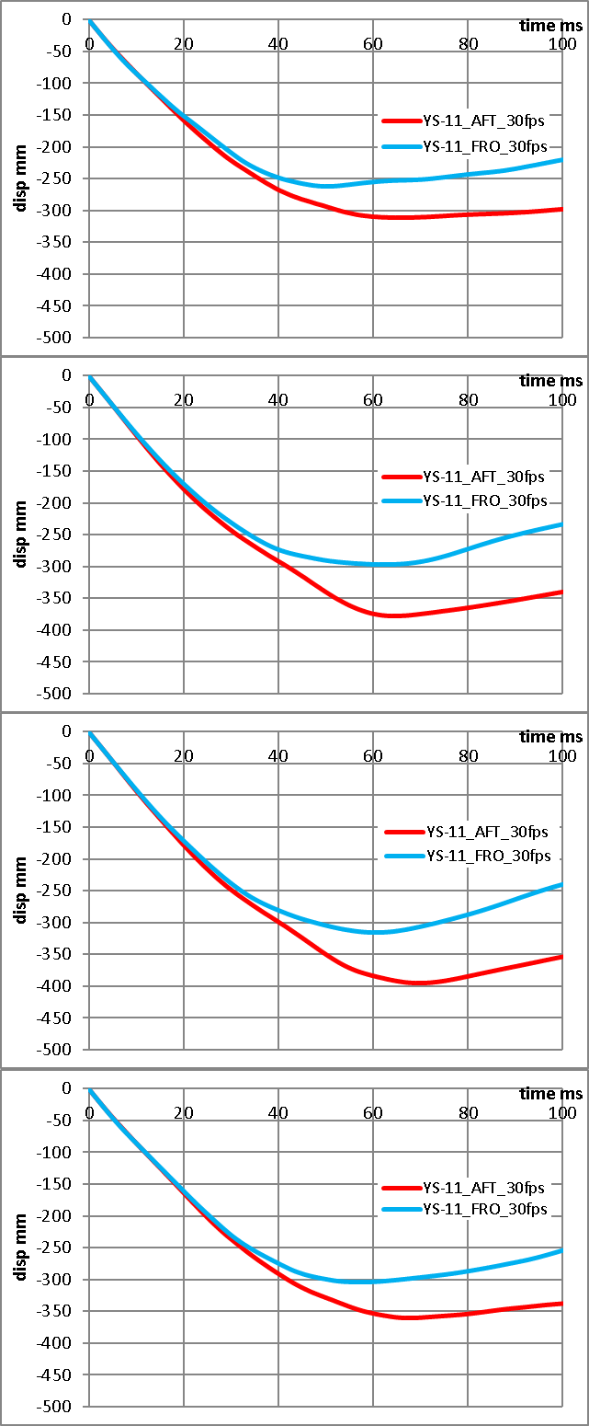
Comparison of two models at 30fps impact
Analysis result comparison –displacement time histories of cabin floor
4th row
7th row
16
15
14
13
09
13
12
11
10
09
10
14
11
15
16
15
14
13
12
11
10
09
12
16

Slide 21
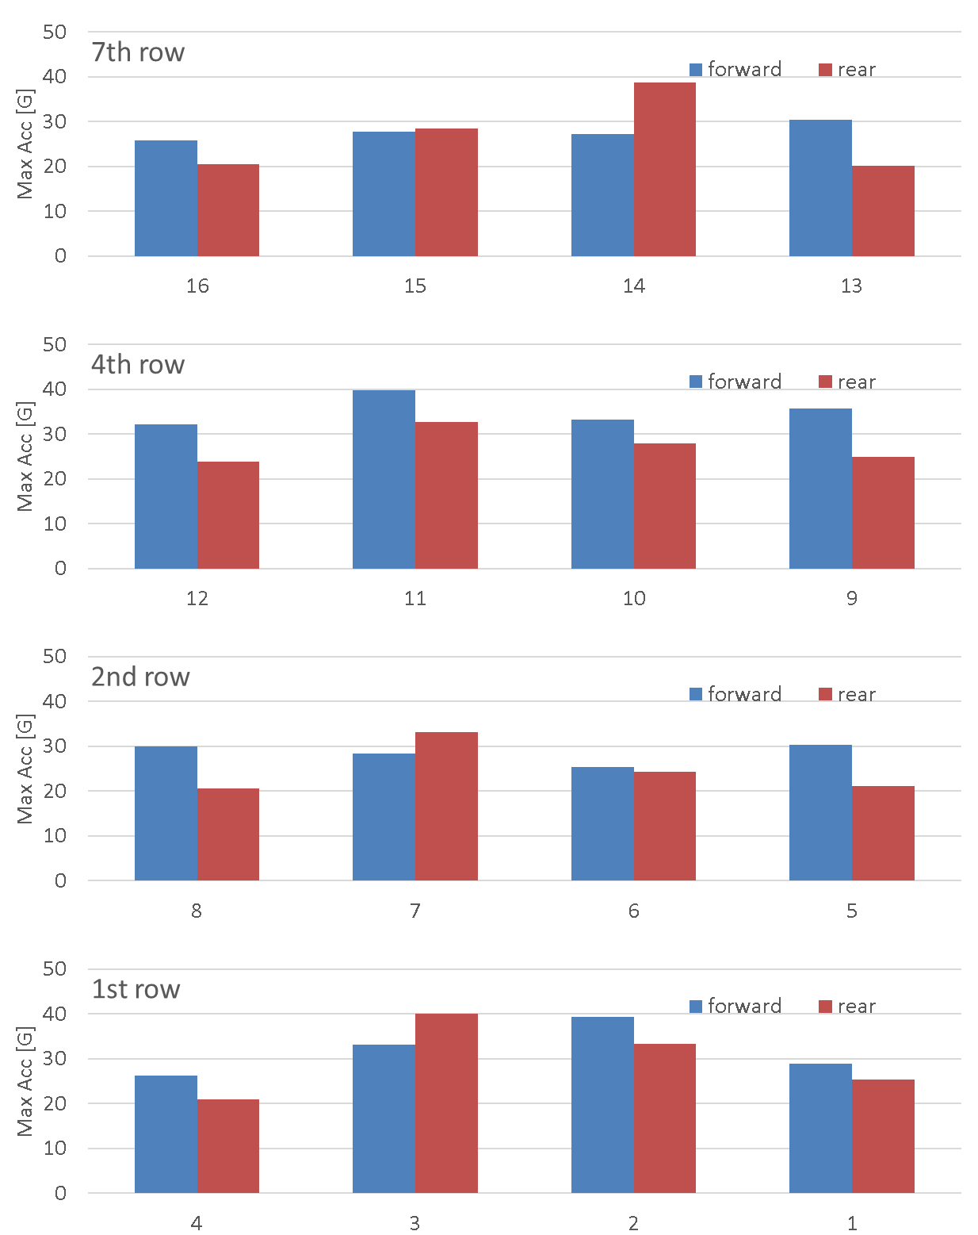
Comparison of two models at 30fps impact
Analysis result comparison –acceleration maximum values
16
15
14
13
12
11
10
09
08
07
06
05
04
03
02
01
16
15
14
13
12
11
10
09
08
07
06
05
04
03
02
01

Slide 22
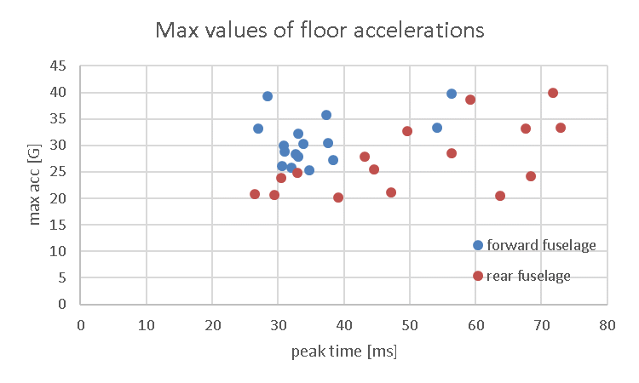
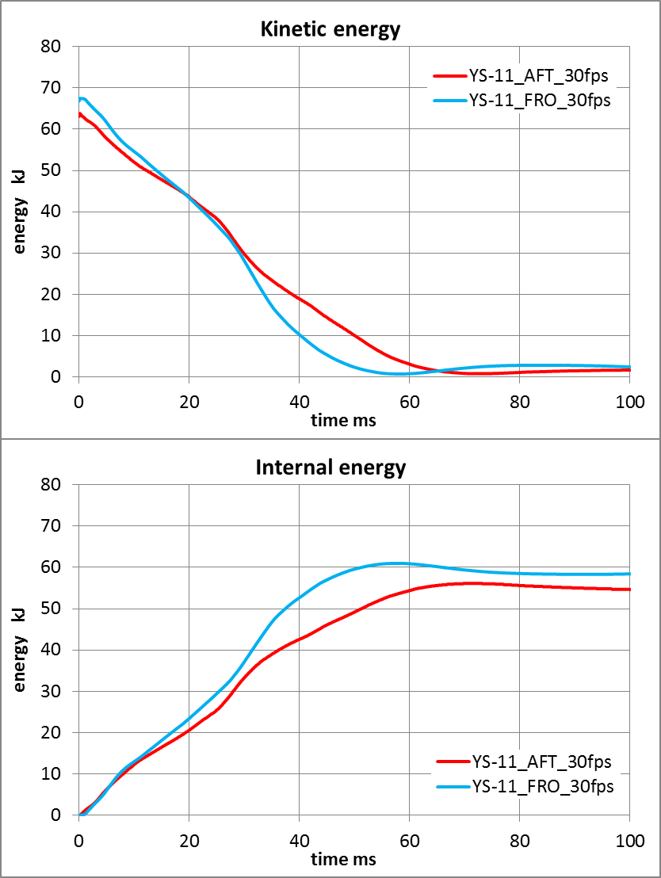
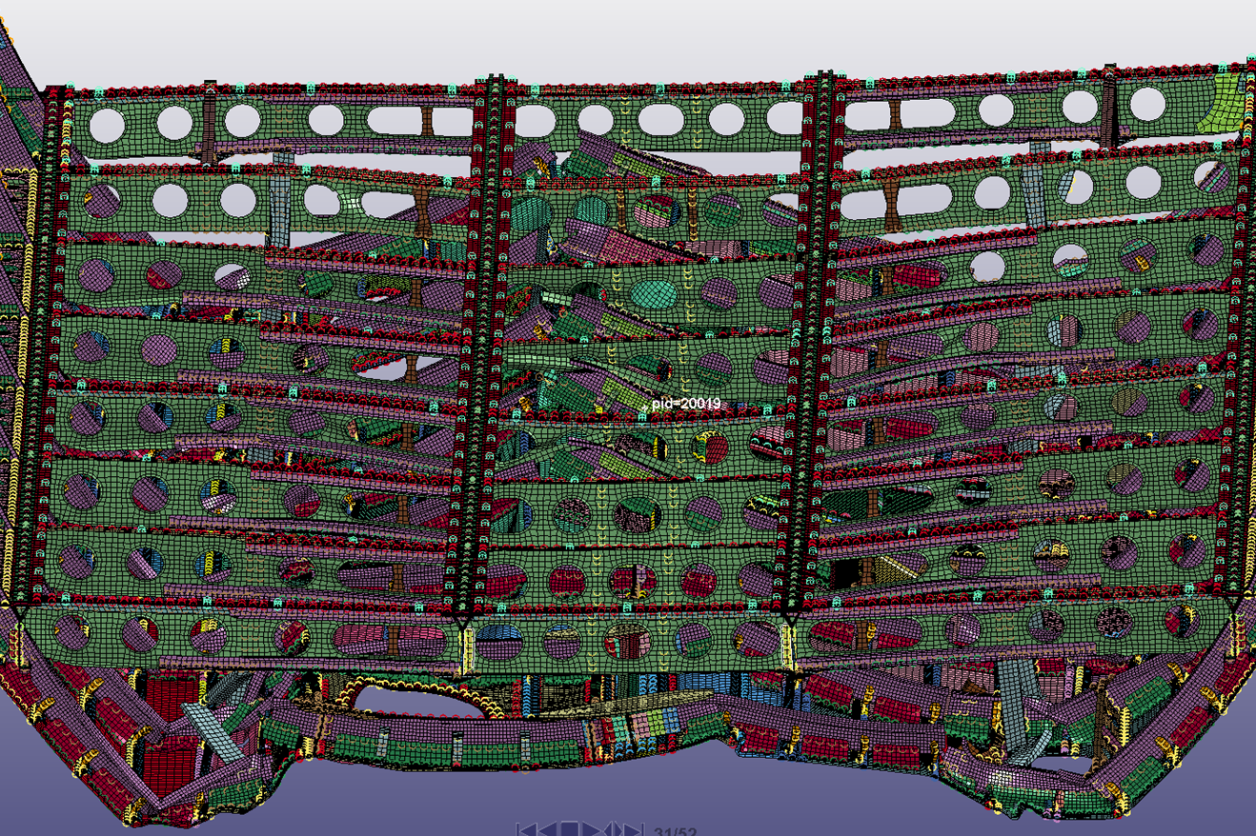
Comparison of two models at 30fps impact
Analysis result comparison –acceleration maximum values cont.
Rear fuselage 60ms after impact

Slide 23
Conclusions
Crash simulations for two YS-11 fuselage sections ware conducted. Fastener characteristics were obtained from the single rivet dynamic tests. Simulation result shows good correlation with the test results on both forward and rear fuselage.
The simulations of two fuselage sections with same impact condition ware conducted and the effect of subfloor structure was evaluated.
In general, cabin floor acceleration has higher peak values in the forward fuselage because of the rigidity of subfloor cargo compartment.
In some point on rear fuselage, high peak value has appeared due to frame/floor contact in some points.

